Slide 1

Doctor Appointment System
Team member
Dhrubo Chandra Mondal(221-15-5329)
Rifat Khan(221-15-5090)
Mannan Hossain(221-15-5176)
Md Osman Goni Khan(221-15-5175)
Md Sohanur Rahman(221-15-4845)

Slide 2
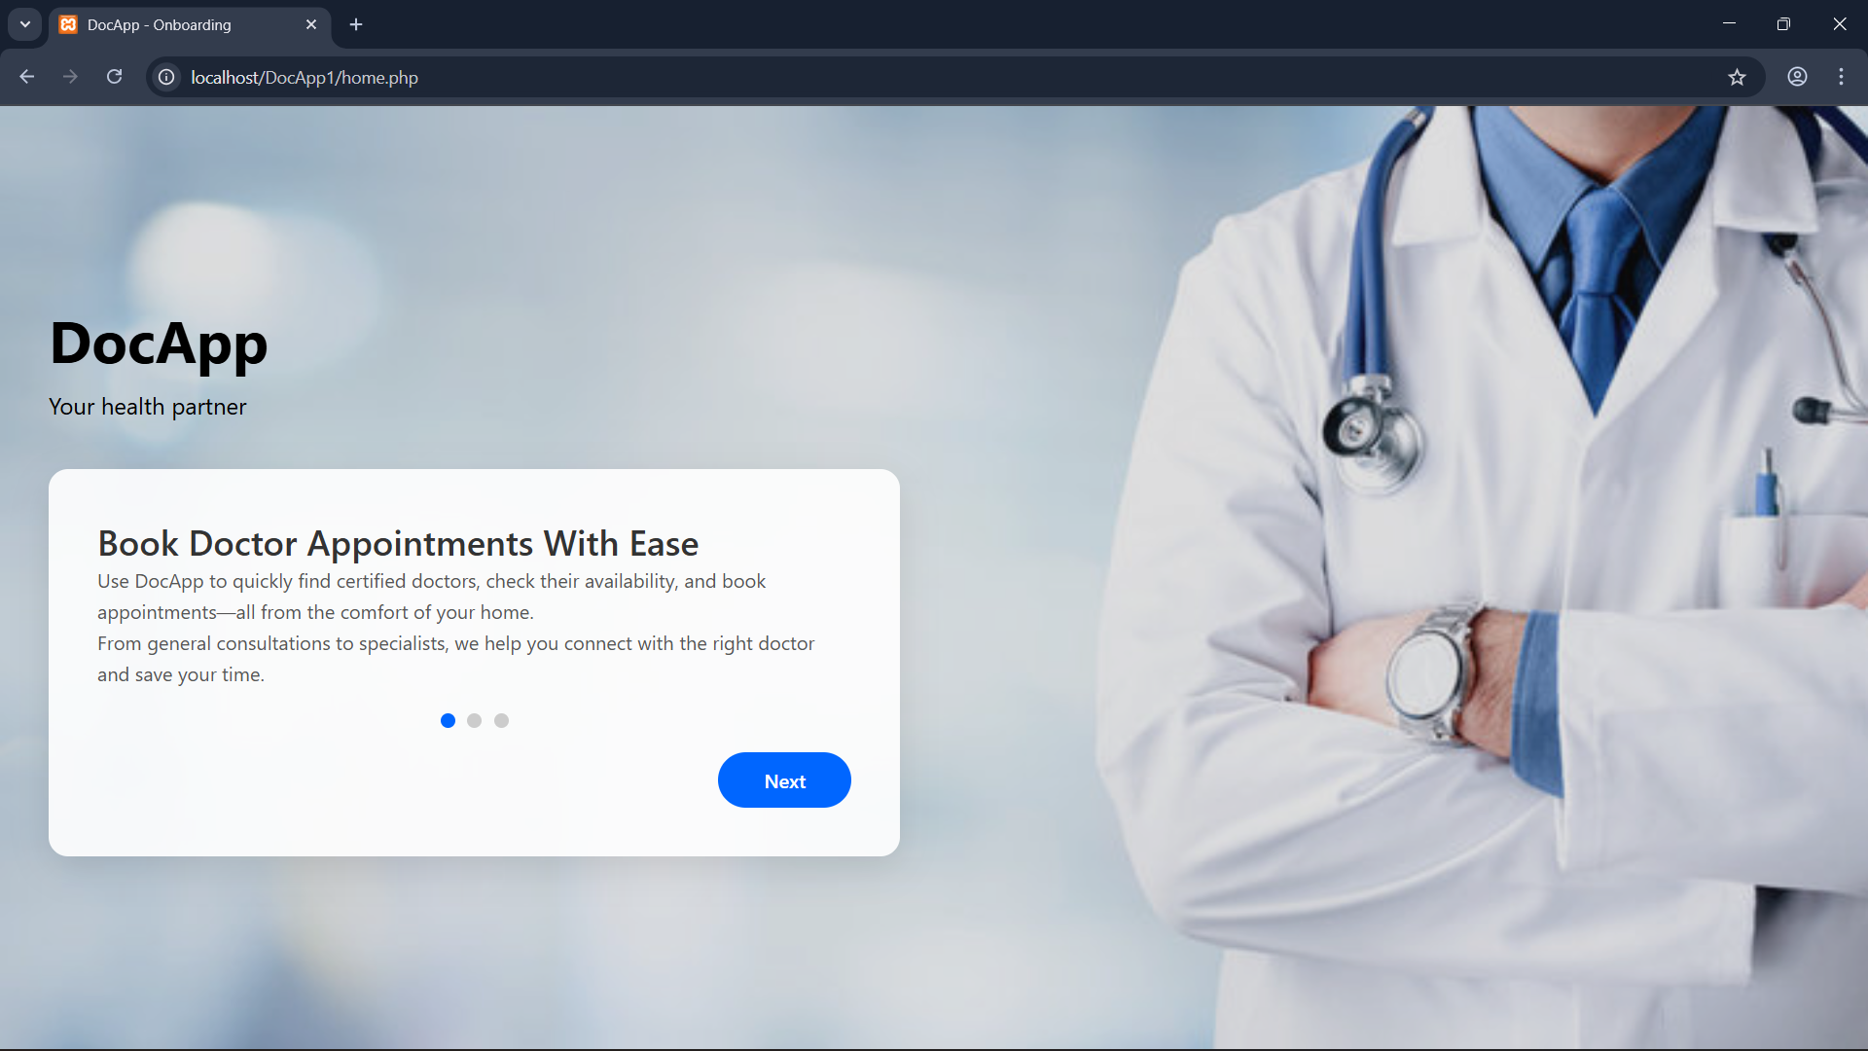
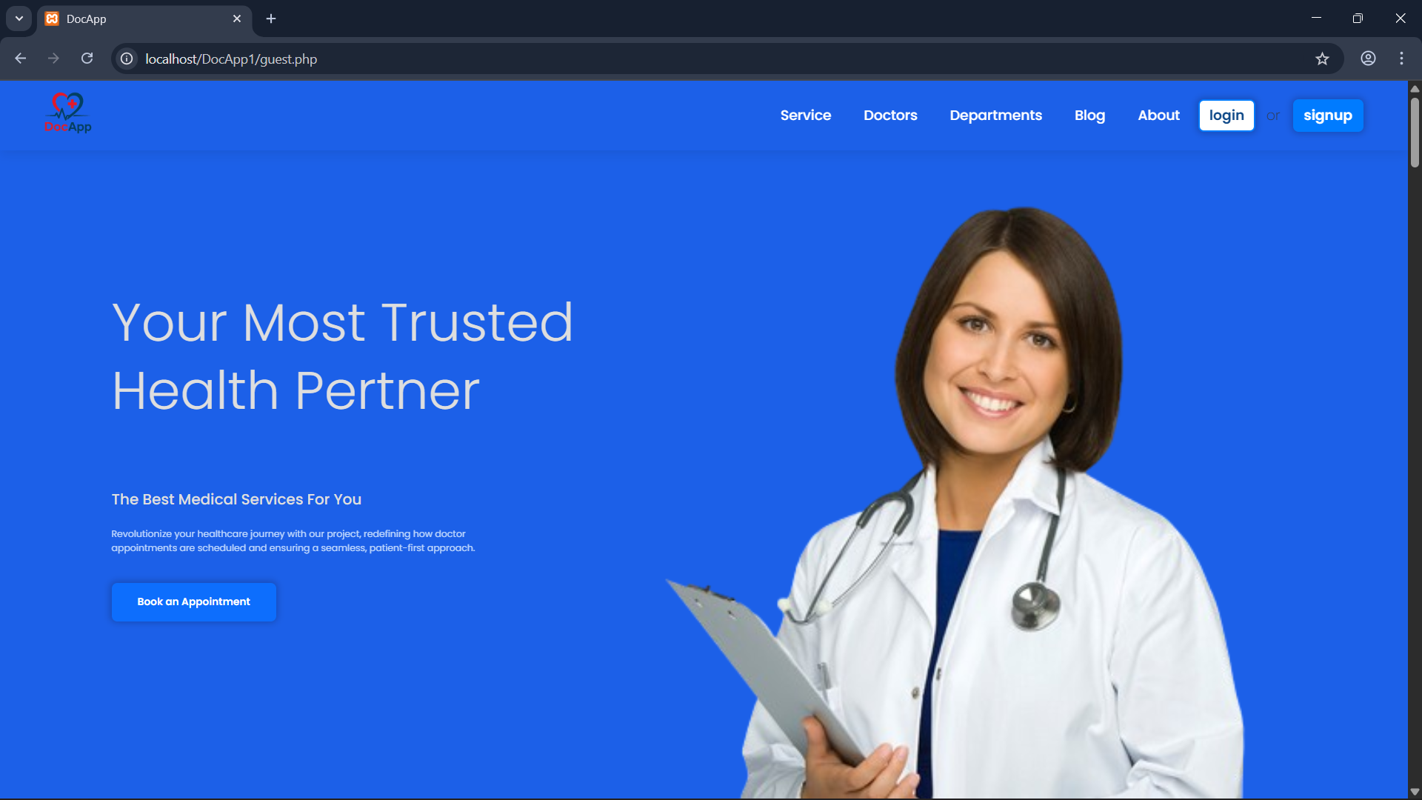
UI Flow(initial)
home.php(Initial)
guest.php(before register)

Slide 3
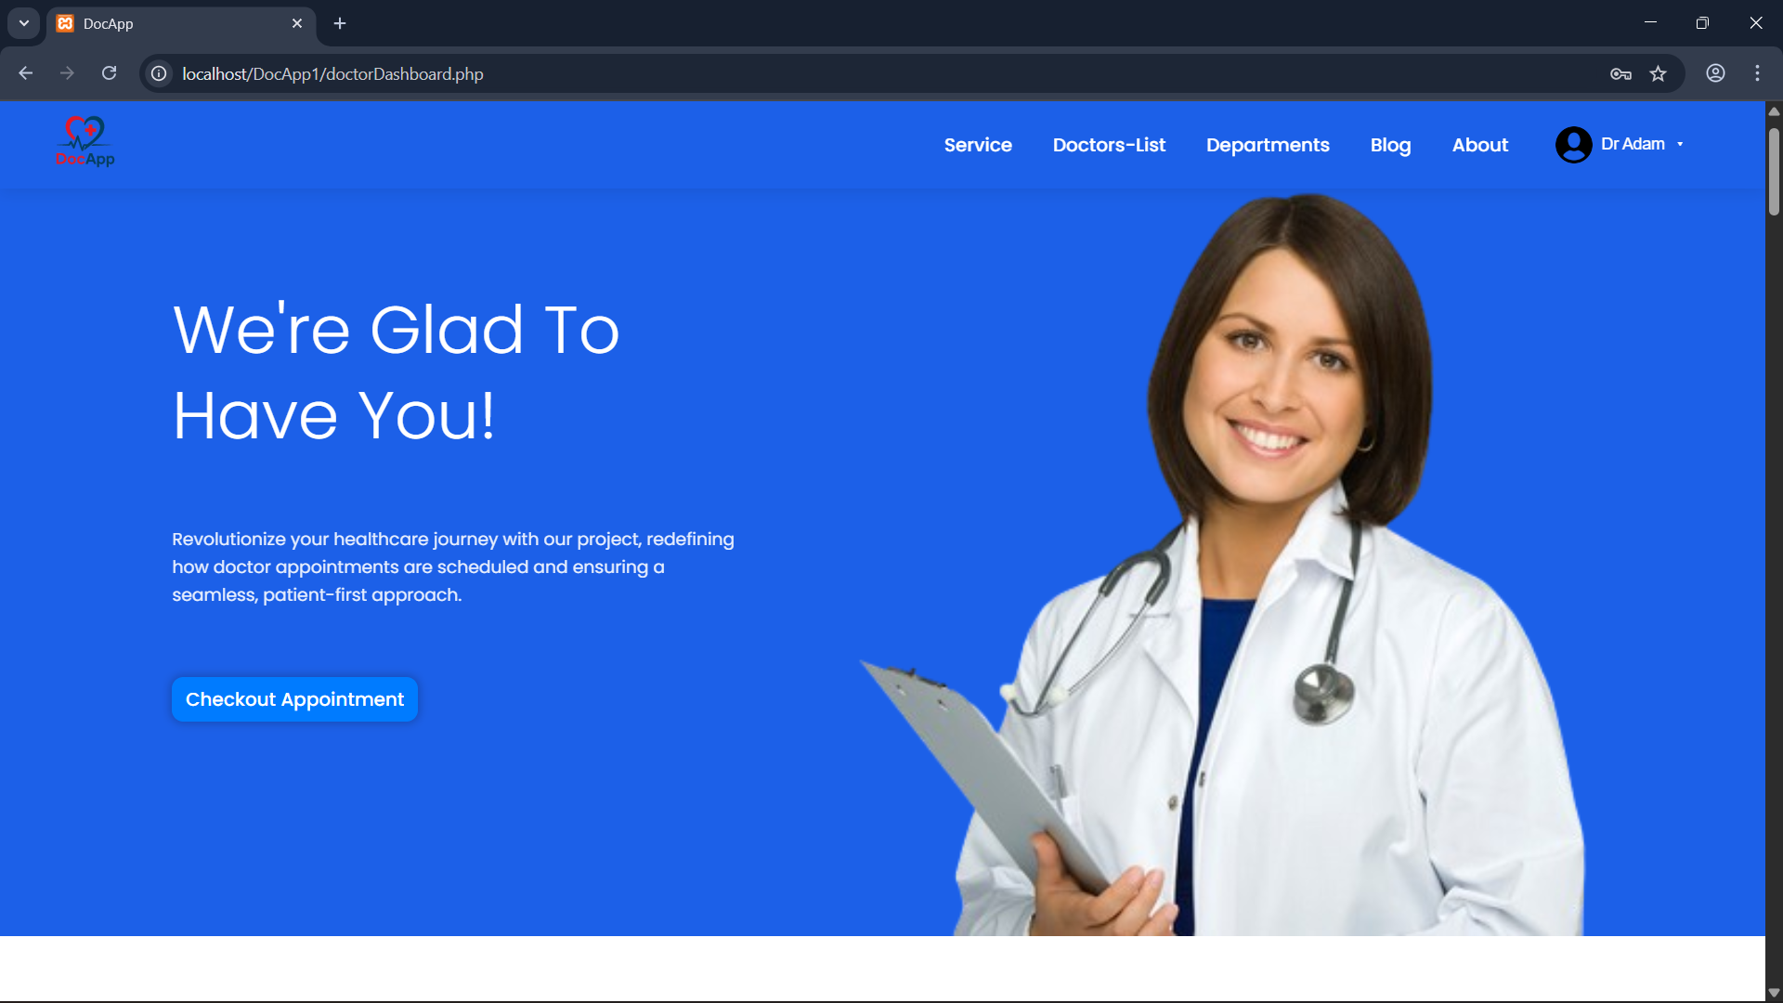
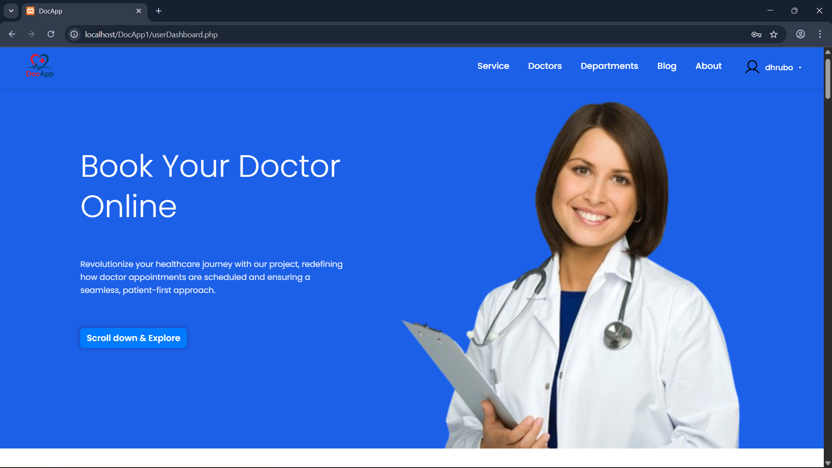
UI Flow(Dashboards)
guest.php(before register)
doctorDashboard.php
userDashboard.php

Slide 4
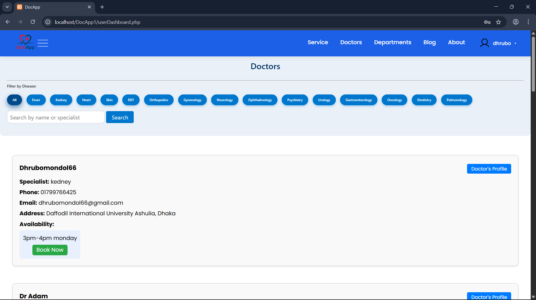
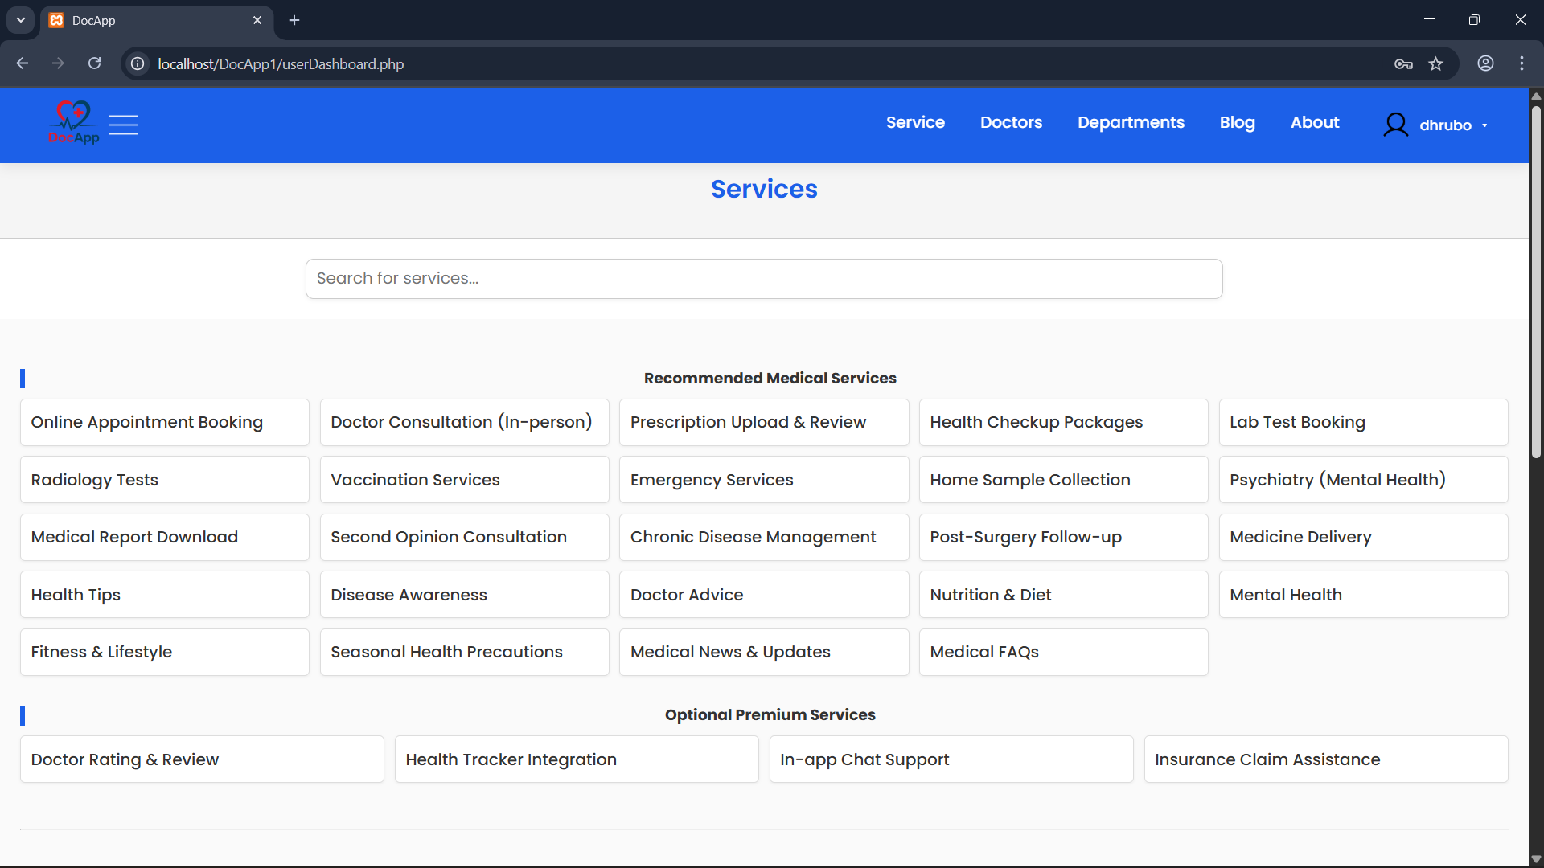
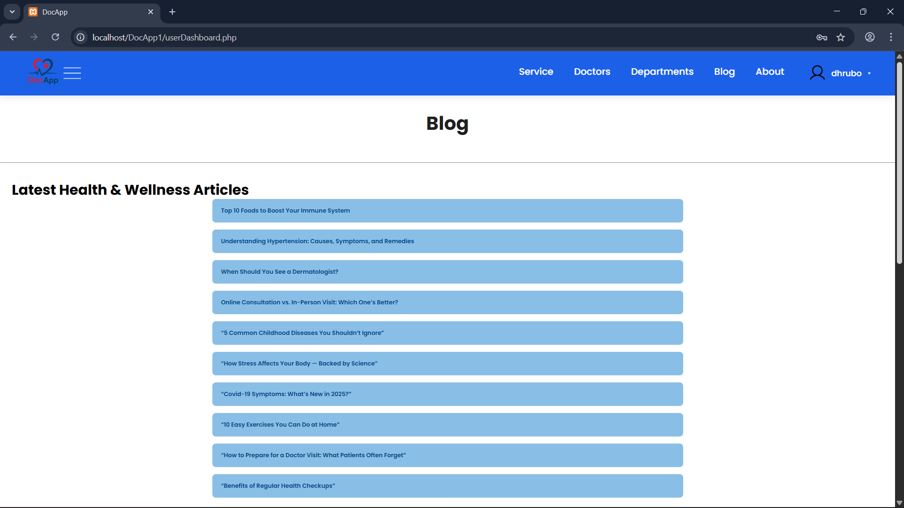
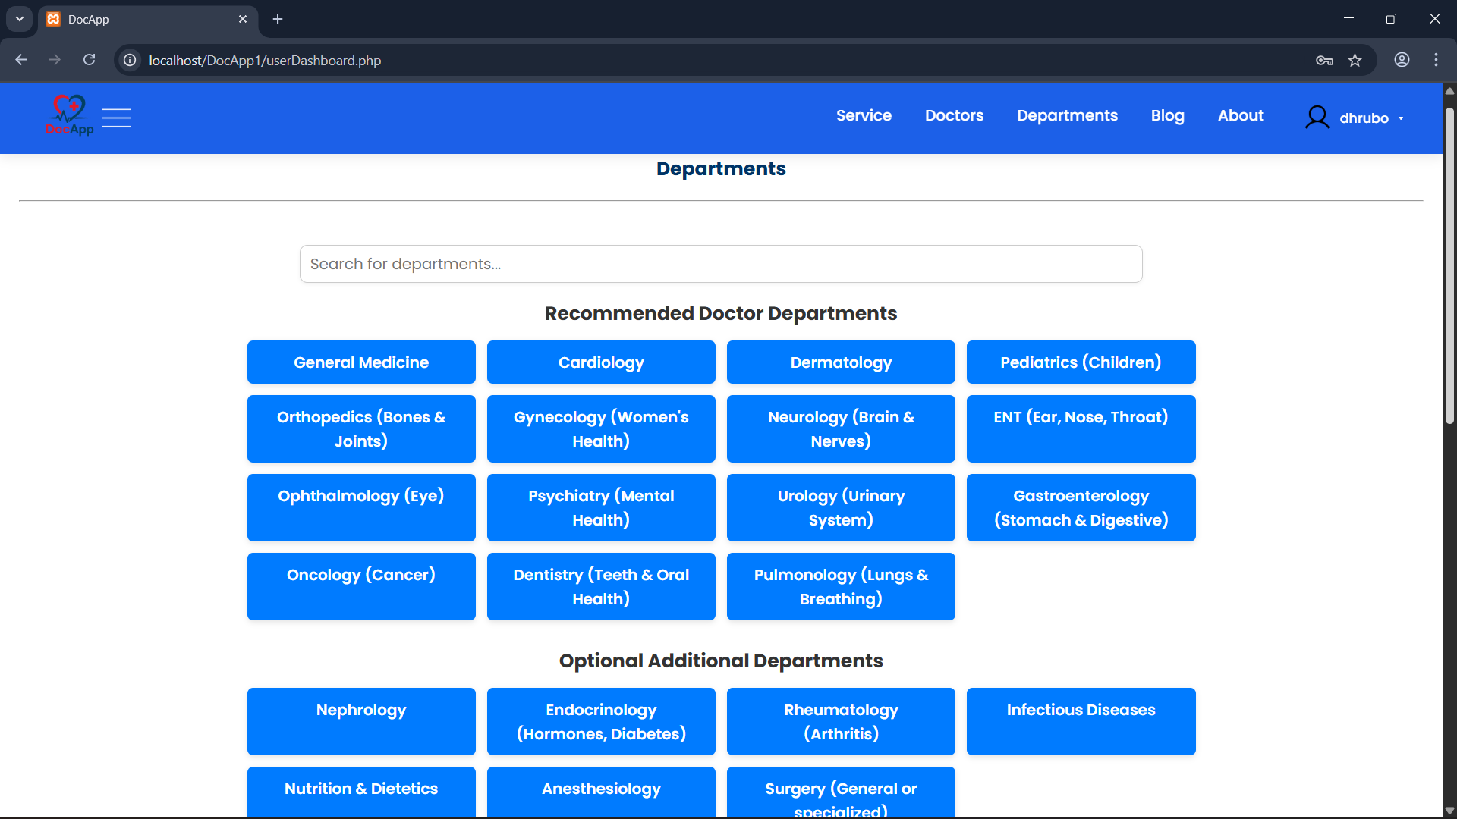
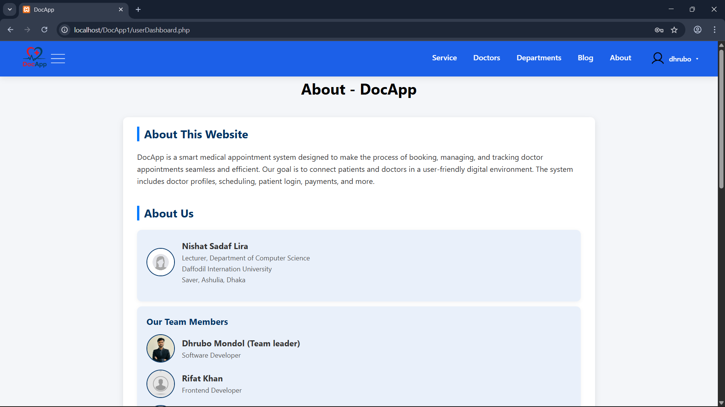
UI Flow(user)
userDashboard.php
bookDoctor1.php
services1.php
blog1.php
department1.php
info.php

Slide 5
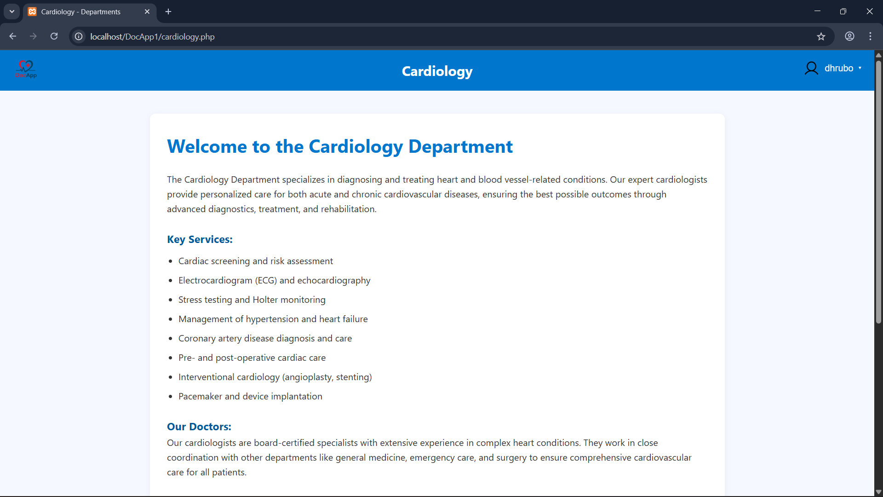
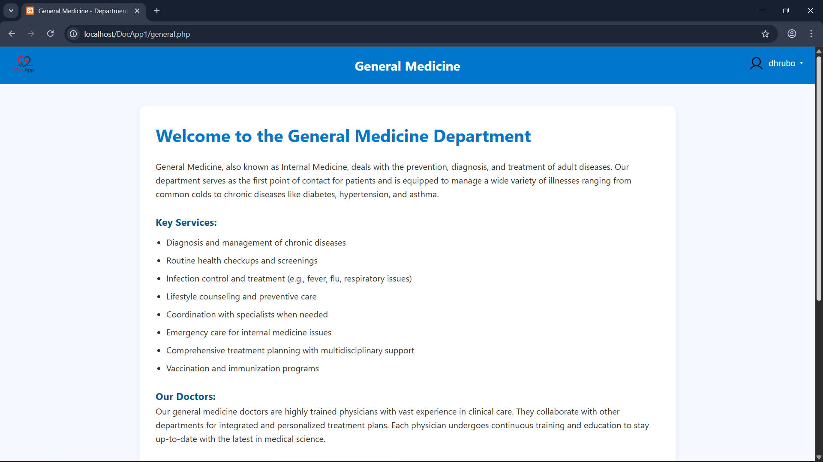
UI Flow(user to department)
department1.php
cardiology.php
general.php

Slide 6
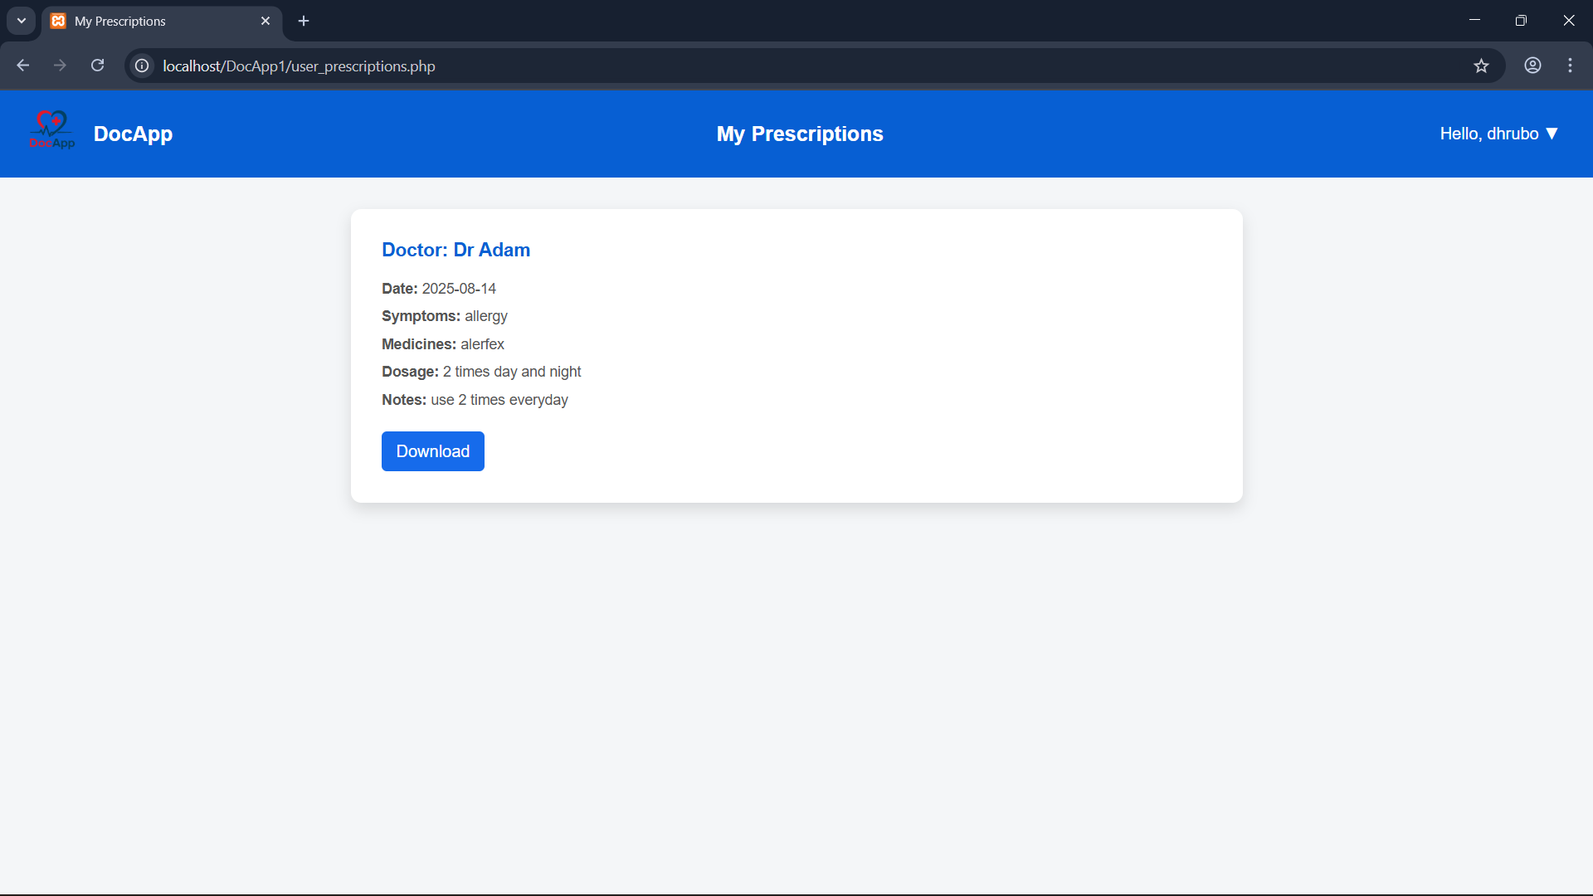
UI Flow(user to services)
services1.php
user_prescription.php

Slide 7
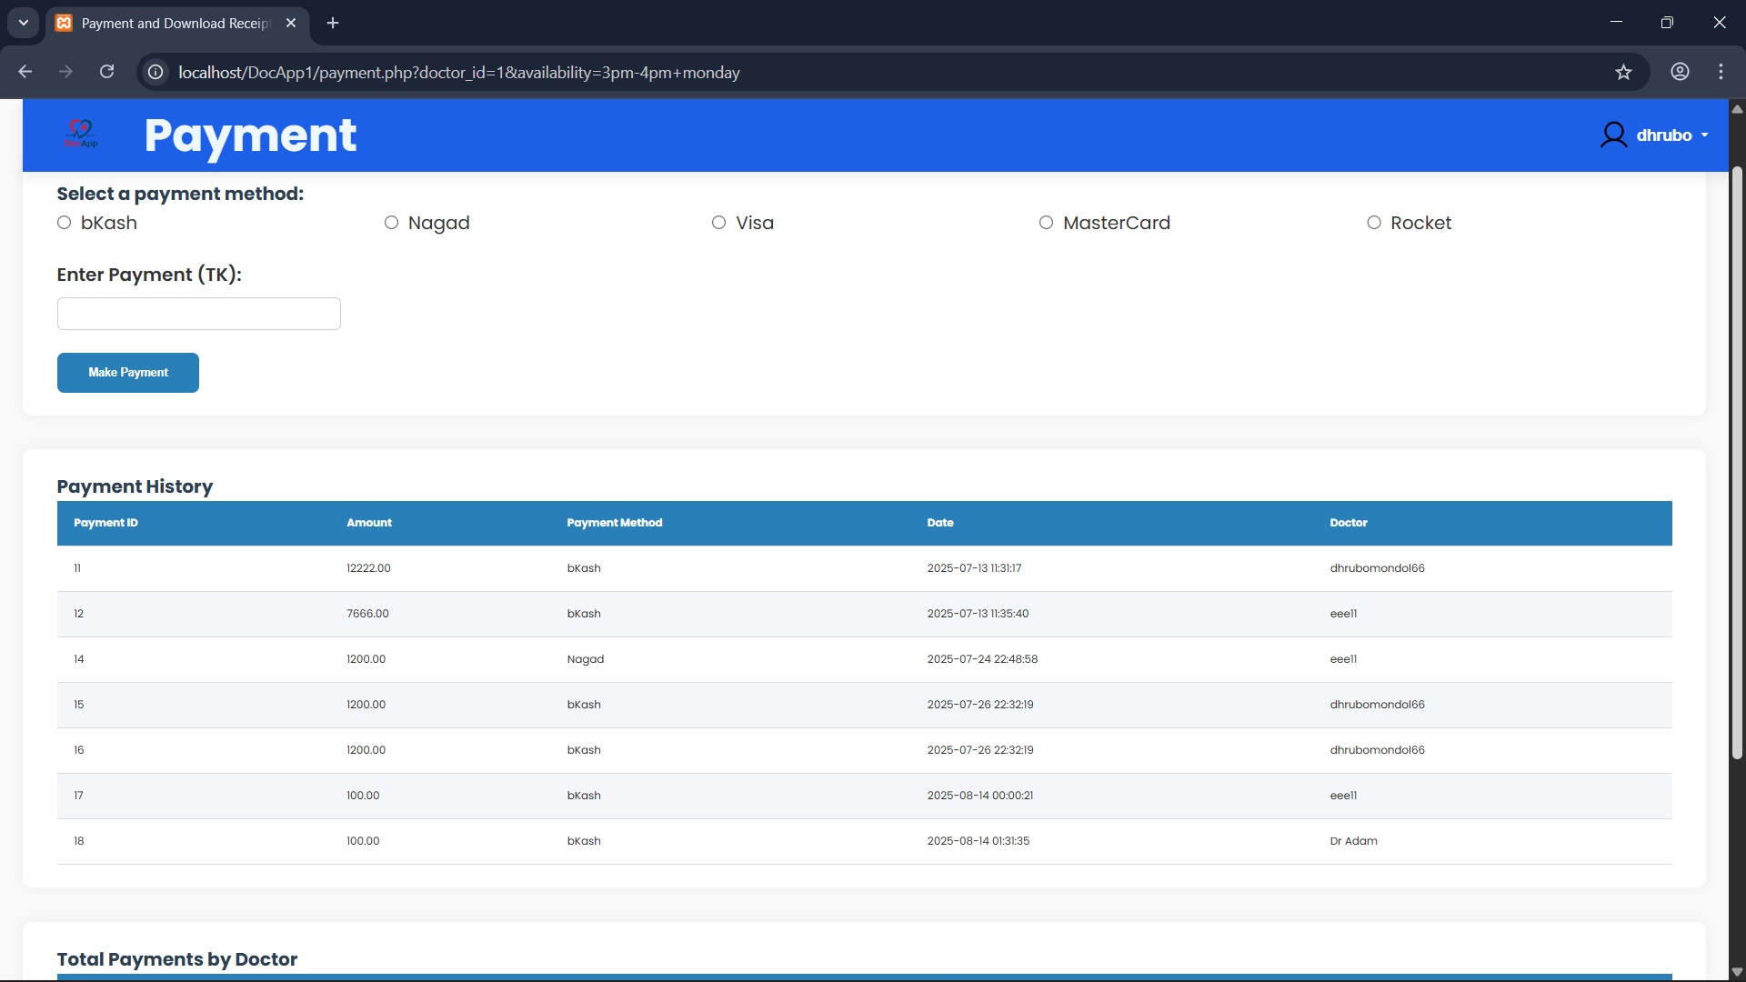
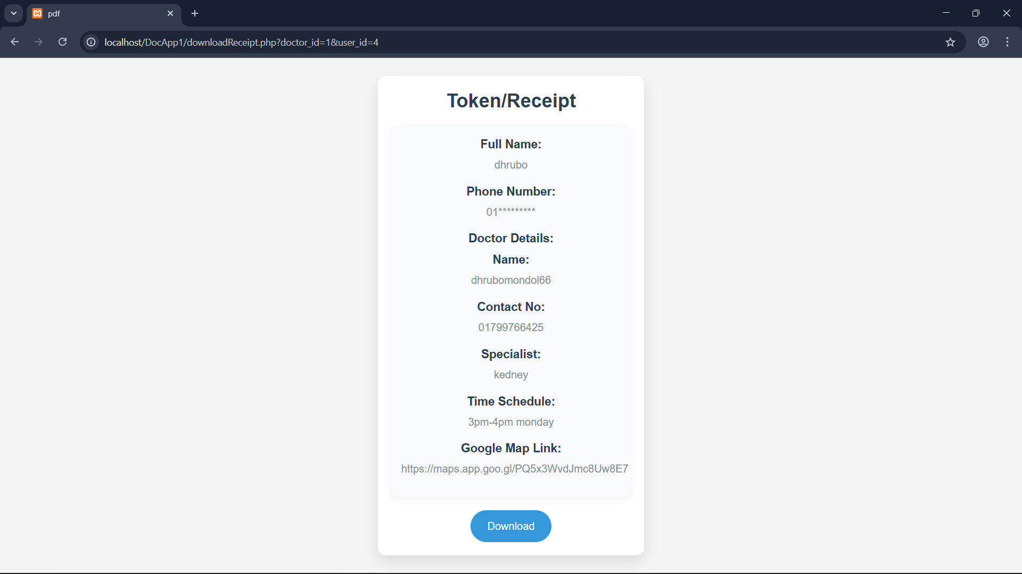
UI Flow(user to book doctors)
bookDoctor1.php
payment.php
download_reciept.php

Slide 8
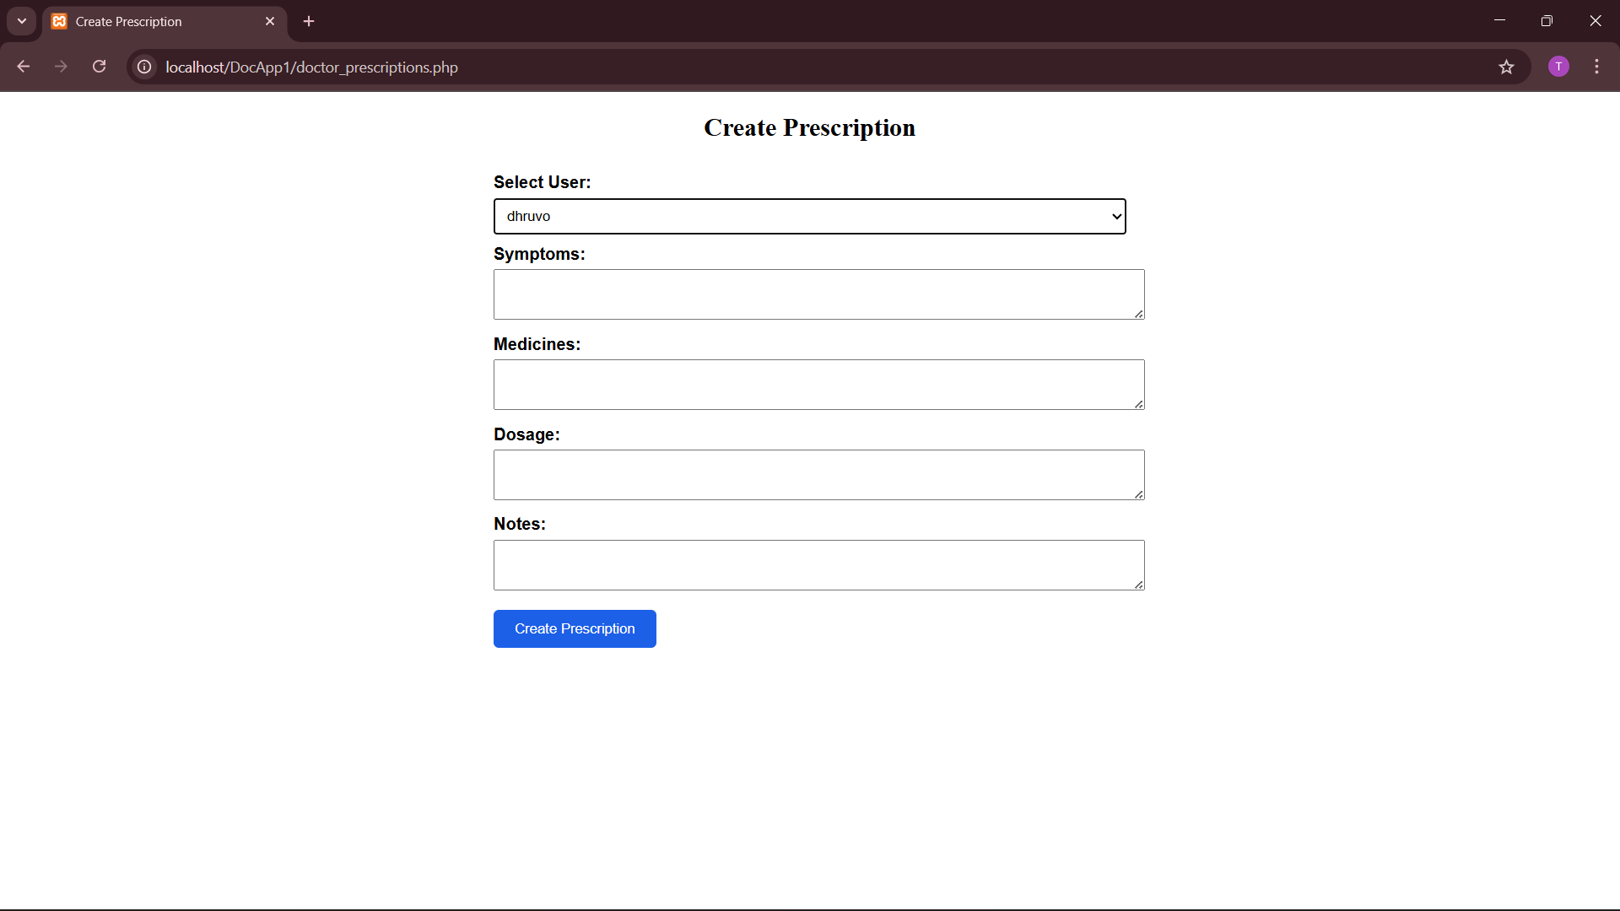
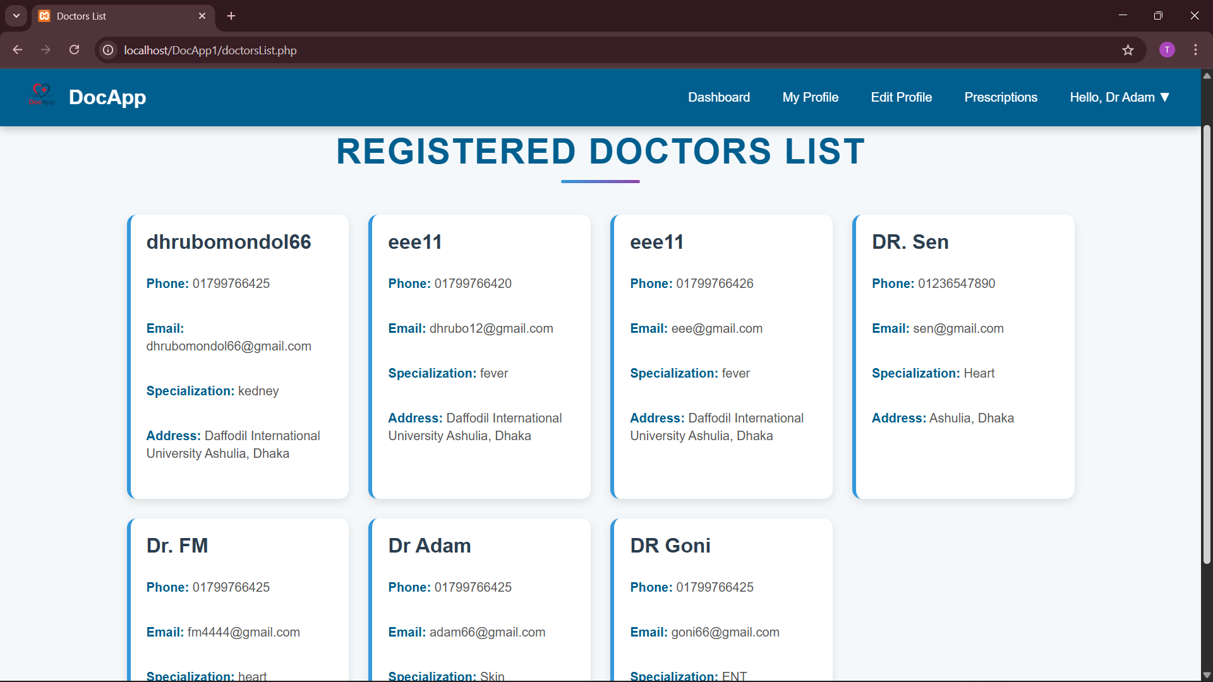
UI Flow(Doctor)
doctor_prescribe.php
doctorDashboard.php
doctorsList.php

Slide 9
Thank you!
Do you have any questions?
+00 000 000 000

